Slide 1
Lesson 8 - Basics of Objects
Mr Mack 2019

Slide 2
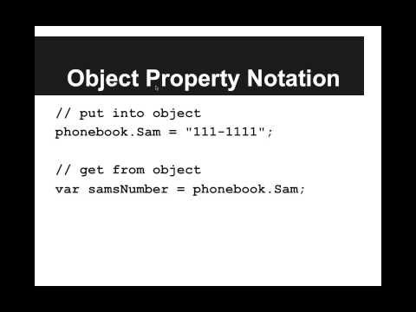
Basics of Objects

Slide 3
We want to make an object phonebook that holds all of our friends’ phone numbers. We only have two friends, Jenny and Soulja Boy. How can we create this object?
var phonebook = {
"Jenny" : "867-5309",
"Soulja Boy" : "678-999-8212"
};
var phonebook = {};
phonebook["Jenny"] = "867-5309";
phonebook["Soulja Boy"] = "678-999-8212";
var phonebook ={};
phonebook.Jenny = "867-5309";
phonebook["Soulja Boy"] = "678-999-8212";
all of the above

Slide 4
How can we get the number for our friend Jenny out of our object phonebook?
var number = phonebook['Jenny'];
var number = phonebook["Jenny"];
var number = phonebook.Jenny;
all of the above

Slide 5
Example: Object Literal Phonebook
This is an example for this lesson. You are encouraged to play around with it, run and change the code, and learn how it works. When you are done, click continue to go to the next problem.

Slide 6
Example: Object Property Phonebook
This is an example for this lesson. You are encouraged to play around with it, run and change the code, and learn how it works. When you are done, click continue to go to the next problem.

Slide 7
Example: Beware Dot Notation!
This is an example for this lesson. You are encouraged to play around with it, run and change the code, and learn how it works. When you are done, click continue to go to the next problem.

Slide 8
Exercise 5.8.1: Address Book
You keep forgetting where all of your friends live, so you’ve decided to write a program to keep track of their addresses for you!
Create a variable addressBook that stores the names and addresses of your friends. Given a friend’s name, you should be able to lookup their address.
The addressBook should be initialized with the following information:
Nemo lives at: P Sherman, 42 Wallaby Way, Sydney
Luna lives at: 20 Ottery Street, Devon, England
Fred lives at: 301 Cobblestone Way, Bedrock, CA
Then change Nemo’s address to be the following address:
124 Conch Street, Bikini Bottom, Pacific Ocean
Then lookup the address for Nemo and print it out to make sure it’s right! We wouldn’t want to lose Nemo. Then we’d have to go find him.

